Slide 1
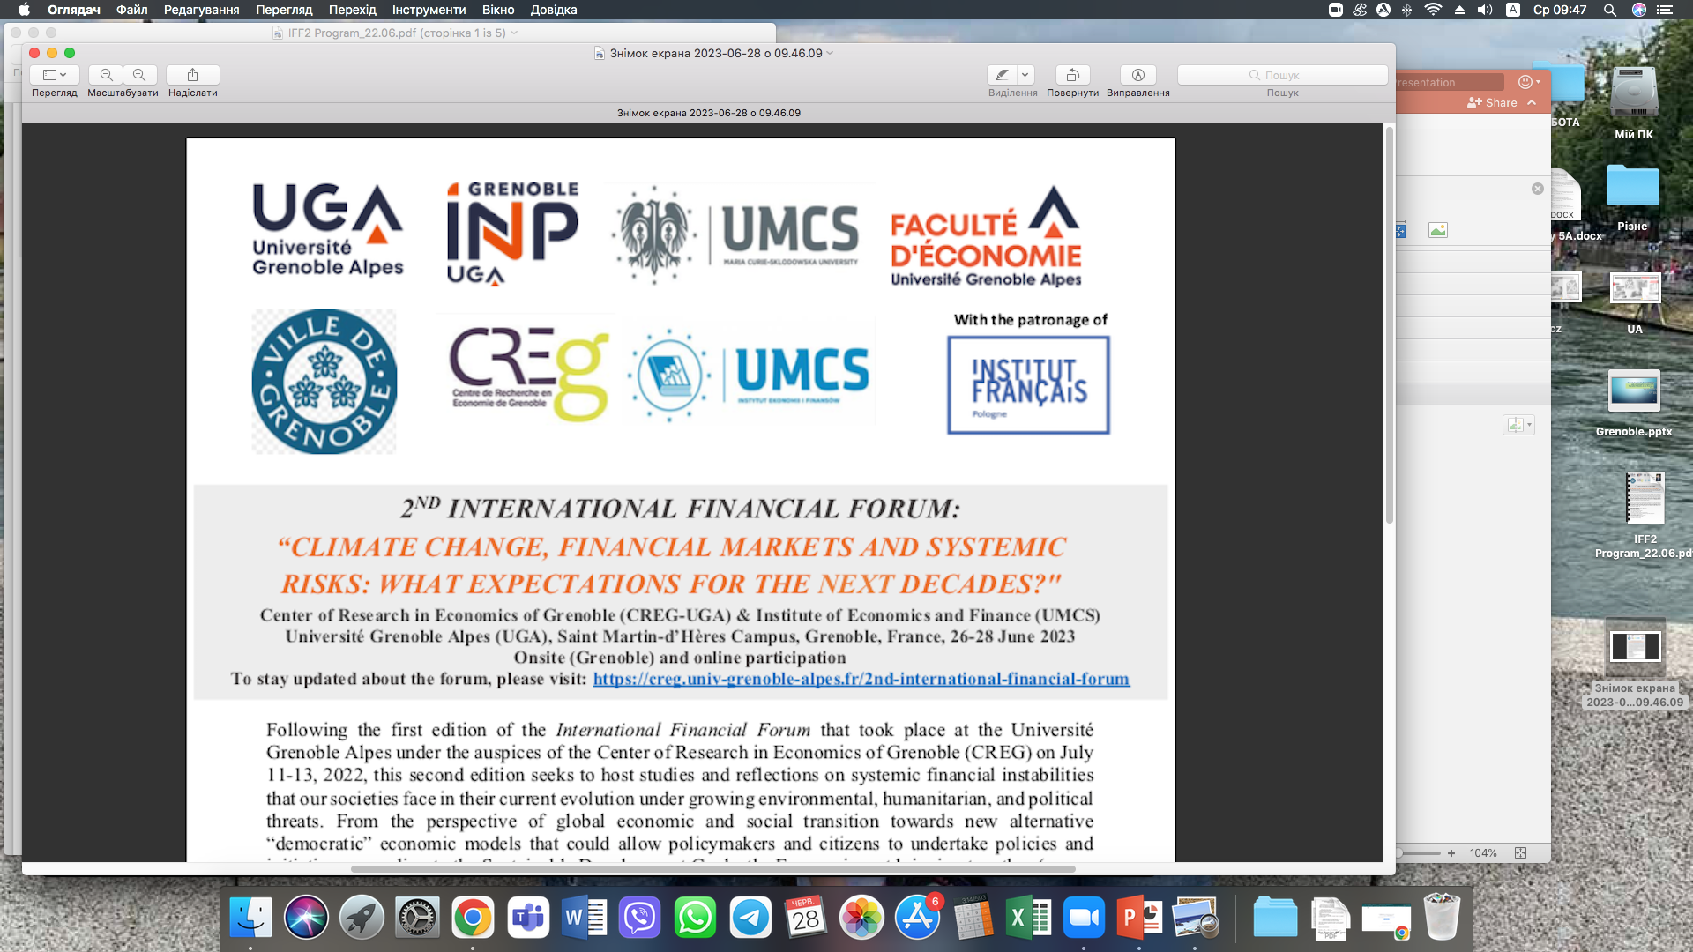

Towards Sustainable Policy: Defining and reforming Environmentally Harmful Subsidies in the European Union
2ND INTERNATIONAL FINANCIAL FORUM:
“CLIMATE CHANGE, FINANCIAL MARKETS AND SYSTEMIC RISKS: WHAT EXPECTATIONS FOR THE NEXT DECADES?"
Center of Research in Economics of Grenoble (CREG-UGA) & Institute of Economics and Finance (UMCS) Université Grenoble Alpes (UGA), Saint Martin-d’Hères Campus, Grenoble, France, 26-28 June 2023 Onsite (Grenoble) and online participation
PREPARED BY:
Dr. Volodymyr SVIRSKYI (Czech Environmental Information Agency)
Prof. Jurij KLAPKIV (University of Lodz-Poland),

Slide 2

The research attempted to find answers to the following questions:
To determine the EHS definition as the starting point of database building
To compile a set of classification criteria for the EHS database (based on existing inventories of EHS)
To suggest the structure (information) of EHS identity card (meta-file)
To develop an analytical framework for choosing EHS for phasing-out
To analyze the data on EHS from recent EU, world and national reports, databases, inventories
Based on internationally developed methodologies and experience of other countries, it has been described how EHS could be identified, assessed and phased-out. The research neither provides a list of all EHS in the EU, nor calculates their total amount.
This research was conducted as a part of work in the project Center for Socio-Economic Research on Environmental Policy Impact Assessment (SEEPIA) at the Czech Environmental Information Agency, and the author would like to express gratitude for the academic environment and resources provided.

Slide 3
interrelation fossil fuel subsidies / energy subsidies / environmentally harmful subsidies
1.defining EHS
The need to identify and phase out environmentally harmful subsidies has been highlighted for decades by international organizations* (OECD, UNEP, UNECE, IMF, the International Energy Agency, the World Bank and the G20 etc.). There are many different definitions of energy subsidies / fossil fuel subsidies. So the additional clarity on the definition of EHS is needed.
fossil fuel subsidies
energy subsidies
environmentally harmful subsidies
*For example, UN Sustainable Development Goal 12.c“; the 7th and 8th Environmental Action Programs (EAP) of the European Union; the Europe 2020 Strategy (European Semester), and Roadmap to a Resource Efficient Europe; the European Green Deal; “Fit for 55” plan: Delivering the EU's 2030 climate targets on the path toward climate neutrality; European Climate Regulation 2021/1119.

Slide 4
1.defining EHS (CONT)
A definition of EHS consists of two distinct parts (a subsidy part and an environmental harm part).
A SUBSIDY PART - In general subsidy is a result of a government action that confers an advantage on consumers or producers, in order to supplement their income or lower their costs.
AN ENVIRONMENTAL HARM PART - A subsidy can be considered potentially harmful to the environment (EHS) if the negative environmental impacts are increasing due to the existence of the subsidy.
Evidently we don’t have the exact and proper theoretical definition of EHS, but this definition approach has a specific practical purpose - basic set of information
needed for a comprehensive database to identifying and phasing out EHS.
Using the broad definition of ‘subsidy’, which is consistent with the approach of EC, OECD, WTO, other international organizations and several national EHS inventories (Sweden, Belgium, Italy Germany) will be helpful in building the classification criteria for the EHS database and future international comparison of EHS.
*A toolbox for reforming environmentally harmful subsidies in Europe https://circabc.europa.eu/ui/group/c1a5a4e9-7563-4d0e-9697-68d9cd24ed34/library/3e685dda-2269-487d-a253-28cfd23b7466/details

Slide 5
1.defining EHS (CONT)
According for the purpose of this overview it is recommended to use the OECD* broad definition of ‘subsidy’ which follows the subsidy definition in the Agreement on Subsidies and Countervailing Measures (ASCM) under WTO.
A subsidy shall be deemed to exist:
1. if there is a financial contribution by a government or any public body within the territory of a country, i.e. where:
i. a government practice involves a direct transfer of funds (e.g. grants, loans, and equity infusion), potential direct transfers of funds or liabilities (e.g. loan guarantees);
ii. government revenue that is otherwise due is forgone or not collected (e.g. fiscal incentives such as tax credits);
iii. a government provides goods or services other than general infrastructure, or purchases goods;
iv. a government makes payments to a funding mechanism, or entrusts or directs a private body to carry out one or more of the type of functions illustrated in (i) to (iii) above which would normally be vested in the government and the practice, in no real sense, differs from practices normally followed by governments.
2. Or if there is any form of income or price support in the sense of Article XVI of GATT 1994.
3. And if a benefit is thereby conferred.
OECD Fossil Fuel Support Portal Methodology https://www.oecd.org/fossil-fuels/methodology/

Slide 6
1.defining EHS (CONT)
Taking into account the interrelation between
fossil fuel subsidies / energy subsidies / environmentally harmful subsidies (EHS is the broadest one) and considering the OECD’s broad definition of support (was adopted in 2019*) it is recommended to analyze the possibility to use in the future the definition of SUPPORT, instead of definition subsidy
Using the broad definition of ‘subsidy’, which is consistent with the approach of EC, OECD, WTO, other international organizations and several national EHS inventories (Sweden, Belgium, Italy Germany) will be helpful in building the classification criteria for the EHS database and future international comparison of EHS.
*The OECD’s broad definition of support was adopted in 2019 to track and measure the Sustainable Development Goal Indicator 12.c.1 on fossil-fuel subsidies, in a joint publication by UNEP, IISD and OECD. OECD Fossil Fuel Support Portal Methodology https://www.oecd.org/fossil-fuels/methodology/

Slide 7
2. classification criteria for the EHS database
2.1. TYPE OF ENVIRONMENTAL IMPACT
Identifying the TYPE OF ENVIRONMENTAL IMPACT is the starting point in the process of classification of EHS
The analyze of significant harm (Art. 9 & 17 of the EU Taxonomy Regulation*) should be taken while classification of EHS according to their influence to one of six environmental objectives
Unfortunately in most of the cases it is possible only assess qualitatively the different environmental impacts of EHS, as very little quantitative data is available (based on overview of OECD, EU and national inventories on EHS).
*Regulation (EU) 2020/852 of the European Parliament and of the Council of 18 June 2020 on the establishment of a framework to facilitate sustainable investment, and amending Regulation (EU) 2019/2088 https://eur-lex.europa.eu/legal-content/EN/TXT/?uri=CELEX:32020R0852

Slide 8
2. classification criteria for the EHS database
2.1. TYPE OF ENVIRONMENTAL IMPACT (CONT)
Unlike the toolbox for reforming EHS in Europe which gives qualitative assessment of EHS according to the specified environmental impacts such as GHG emissions, air pollution, land and water use, biodiversity etc. it is proposed to use six environmental objectives according to the new EU Taxonomy Regulation.
There is a technical guidance* that defines what constitutes ‘significant harm’ for the six environmental objectives covered by the Taxonomy Regulation:
*Technical guidance on the application of ‘do no significant harm’ under the Recovery and Resilience Facility Regulation. Commission Notice (2021/C 58/01). Available at: https://eur-lex.europa.eu/legal-content/EN/TXT/?uri=CELEX%3A52021XC0218%2801%29

Slide 9
2. classification criteria for the EHS database
2.2. Support Mechanism
Subsidies are also often categorised based on the nature of the instrument that is used to provide them. Taking into account the different approaches to Support Mechanisms of EHS (UNEP, IISD, OECD etc.), based on the Agreement on Subsidies and Countervailing Measures (ASCM) under the World Trade Organization (WTO) it is proposed to use 4 basic support mechanisms of EHS:
Direct transfers
Income or price supports
Tax expenditures
Transfer of risks

Slide 10
2. classification criteria for the EHS database
2.2. Support Mechanism (CONT)

Slide 11
2. classification criteria for the EHS database
2.2. Support Mechanism (CONT)

Slide 12
2. classification criteria for the EHS database
2.2. Support Mechanism - data availability
Data on fossil fuel subsidies are being collected nationally, by governments and other institutions, and internationally, through peer-reviews and by intergovernmental organizations.
The IEA, IMF and OECD are regularly collecting data on production or consumption subsidies to build up international databases.
The measurement of EHS requires some degree of judgement by the analyst. Some Support Mechanisms are simple to measure, while others involve complex calculations, detailed data, and sometimes simplifying assumptions.
The UNEP/IISD* analysis of the 4 basic support mechanisms showed that there are large differences in terms of data availability, complexity of calculation, and acceptance by governments and researchers. Nevertheless it is recommended to use 4 basic support mechanisms for a comprehensive database to identifying and phasing out EHS.
*UNEP (2019). Measuring Fossil Fuel Subsidies in the Context of the Sustainable Development Goals Available at: https://www.unep.org/resources/report/measuring-fossil-fuel-subsidies-context-sustainable-development-goals

Slide 13
2. classification criteria for the EHS database
2.2. Support Mechanism – How to measure different types of EHS
Eurostat summarizes and briefly describes the different types EHS (definition of PEDs (‘potentially environmentally damaging subsidies’) is used) in each case explaining or proposing how they could be measured (table). It is useful methodological approach while assessment of EHS.
* Eurostat (2019) Potentially environmentally harmful subsidies – definitions and approaches for measurement [draft of 4 October 2019] Available at: https://seea.un.org/sites/seea.un.org/files/harmful_subsidies_definitions_and_approaches_for_measurement_0.pdf

Slide 14
2. classification criteria for the EHS database
2.3. Support By sector
Understanding the structure of the beneficiaries is important for the organization of reforming EHS. It shows some trends in terms of economic sectors benefitting the most from the different EHS.
It is obvious that in most cases that several sectors could be selected for the same subsidy.
This classification criteria allows the identification of beneficiaries that would be impacted by EHS phasing out.
It is proposed to use the Nomenclature of Economic Activities classification (NACERev2*) while identifying the key sectors of economy supported by EHS.
*The Statistical classification of economic activities in the European Community, abbreviated as NACE, is the classification of economic activities in the European Union (EU); the term NACE is derived from the French Nomenclature statistique des activités économiques dans la Communauté européenne. The complete list of NACE codes is available here: https://ec.europa.eu/competition/mergers/cases/index/nace_all.html

Slide 15


2. classification criteria for the EHS database
2.4. Type of Beneficiary
Consumer and producer subsidies are frequently treated separately. The OECD isn’t currently the only organization making a statistically clear distinction between consumer and producer subsidies*. For example SDG Indicator 12.c.1 explicitly mentions subsidies to fossil fuel production and consumption. The ODI also distinguishes these two basic types**.
It is recommended to use the classification criteria «Type of Beneficiary» for a comprehensive database to identifying and phasing out EHS and distinguish two basic types:
Production
Сonsumption
*UNEP (2019). Measuring Fossil Fuel Subsidies in the Context of the Sustainable Development Goals. Available at: https://www.unep.org/resources/report/measuring-fossil-fuel-subsidies-context-sustainable-development-goals
**Phase-out 2020: monitoring Europe’s fossil fuel subsidies. Available at: https://cdn.odi.org/media/documents/11777.pdf

Slide 16
2. classification criteria for the EHS database
2.5. Not recommended items of classification
Fuel type
The range of fuels covered by the different of FFS/EHS inventories comprises both primary fossil-fuel commodities (e.g. crude oil, natural gas, coal, and peat) and secondary refined or processed products (e.g. diesel fuel, gasoline, kerosene, and coal briquettes).
Taking into account the interrelation between fossil fuel subsidies / energy subsidies / environmentally harmful subsidies and considering that the EHS cover much wider scope than just fuel it is not recommended to use «Fuel type» as classification criteria for the EHS database.
Inaction
Inaction can also be considered as an EHS item.
In most of the cases it is possible assess qualitatively the different impacts of inaction as EHS, as quantitative data is scarcely unavailable.

Slide 17

2. DRAFT of classification criteria for the EHS database

Slide 18
3. EHS identity card (meta-file)
EHS identity card (meta-file) is important tool to understand the effect of the subsidy in terms of its economic, environmental and other impacts during analysis of the potential candidates for phase out.
A good understanding of the range of impacts can help policymakers understand when a political window of opportunity occurs to drive a successful process of EHS phase out
BASIC Features of EHS
Description of the subsidy
Impact chain
Environmental impacts
Budgetary impacts
Subsidy beneficiaries
Additional details concerning the subsidy

Slide 19

3. EHS identity card (meta-file)
3.1. Description of the subsidy
Main conditions of the subsidy:
- name of the subsidy
responsible authority
monetary value (€/CZK)
EU co-financing (No / yes (%))
level of phasing-out (regional, national, EU, global)
year of implementation
purpose of the subsidy
type of support mechanism
legal context
*Available at:

Slide 20
3. EHS identity card (meta-file)
3.2. Impact chain
Impact chain describes the following parts*:
(i) Subsidy: How did the subsidy change the situation of the recipients compared to the situation without the subsidy (the counterfactual).
(ii) Driver: How were the incentives of the recipients changed due to the subsidy? Which fuel, production techniques or consumption became more or less attractive due to the subsidy?
(iii) Outcomes: What were the outcomes of those changed incentives? What resources were used more or less; which sectors produced more or less?
(iv) Impacts: What were the impacts of these changed outcomes in respect to emissions/environmental impacts or for the stakeholders in the sectors?
Unlike FFS EHS deal with their less clear and more diverse impact chains.
* A toolbox for reforming environmentally harmful subsidies in Europe. Available at: https://circabc.europa.eu/ui/group/c1a5a4e9-7563-4d0e-9697-68d9cd24ed34/library/3e685dda-2269-487d-a253-28cfd23b7466/details

Slide 21
3. EHS identity card (meta-file)
3.3. Environmental impacts
Environmental impacts should describe what are the nature and extent of the negative environmental impact, including on the climate.
The nature and extent of the direct/indirect impacts of the EHS should be described on the basis of qualitative and where possible quantitative information available. Usually quantitative information on environmental impacts is scarce.
Environmental impacts of reform can be linked to existing reduction targets, it can be an important driver of choosing EHS for phasing-out especially if these reduction targets are based on some international agreement or EU commitments. For example they can describe which of the environmental objectives of EU Taxonomy Regulation are effected

Slide 22

3. EHS identity card (meta-file)
3.4. Budget impacts
Quantitatively budget impacts are most regularly assessed.
It is relatively easy to find in the case of direct budget transfers and tax exemptions, being more complex in the case of transfer of risks and indirect subsidies.

Slide 23

3. EHS identity card (meta-file)
3.5. Subsidy beneficiaries
Understanding the beneficiaries of a subsidy and the importance of the subsidy for them is also a crucial precondition for a successful phasing-out strategy.
Vulnerable beneficiaries (Understanding how the impact on those beneficiaries can be softened is important, both in terms of political feasibility and social balance)
Lobby groups (powerful lobbies can be an important obstacle to phasing-out reform even if they are not the direct beneficiary of the EHS)

Slide 24

3. EHS identity card (meta-file)
3.6. Additional details concerning the subsidy (In-depth analysis of EHS Features)
Intersectoral effects
Interstate effects
Unexpected impacts and long term effects
International agreements concerning EHS

Slide 25
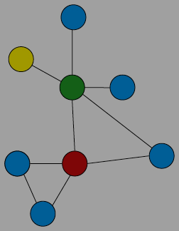
3.6.1. Intersectoral effects
It is essential to build more harmonised data sets with clear qualitative and quantitative assessment of not only economic but also environmental and social impact of EHS phasing-out.

Slide 26

3.6.2. Interstate effects
The process of phasing-out of EHS should reflect contribution to EU policy objectives (the European Green Deal, the EU Climate Law, the Governance of the Energy Union, the 8th EAP and the EU Taxonomy and the Recovery and Resilience Plan).

Slide 27


3.6.3. Unexpected impacts and long term effects
The process of phasing-out of EHS should be taken in the broader holistic approach considering long term economic, environmental as well social effects and trade-offs between them.
It is also needed to estimate how will the subsidised sector react to changes in conditions (e.g. production quantities, market share, use of natural resources, price elasticity etc.)

Slide 28
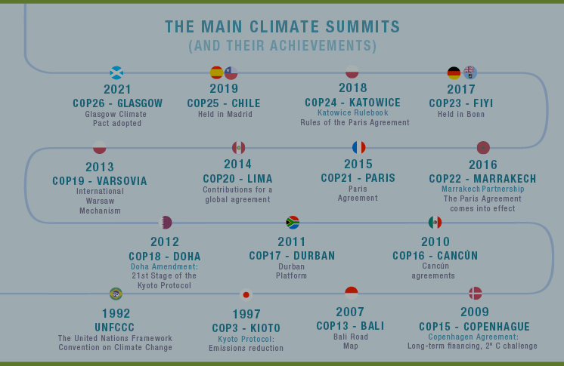
3.6.4. International agreements concerning EHS

Slide 29
4. analytical framework for choosing EHS for phasing-out
Methodologies and guidelines have been developed for the identification and assessment of EHS and have been used by countries and international organizations for a few decades. Less attention is payed to the phasing-out stage.
After an initial identification and assessment of EHS, it is important to carry out a more in- depth assessment in order to clarify the effects of the subsidies and their elimination, and to identify those subsidies that need to be phased-out.
Identifying EHS and assessing their various impacts does not mean abandoning them immediately, but the need to establish a clear understanding of the socio-economic cost of their phasing-out, the availability of better alternatives and the possible compensation mechanisms.

Slide 30

4. analytical framework for choosing EHS for phasing-out
4.1. To set up clear objectives, a timetable and transitional period for implementation EHS phase-out

Slide 31

4. analytical framework for choosing EHS for phasing-out
4.2. To predict The Impacts of EHS and analyze counterfactual situation (situation without EHS)
More qualitative analysis should be undertaken to compare different impacts and ensure that the chosen option does not result in greater environmental impact.
To predict the impact of EHS, expected costs and benefits, pros and cons etc. It is necessary to use Ex Ante Regulatory Impact Assessment.
It is needed to built macroeconomic model that integrates a range of economic, social and environmental processes (e.g. E3ME* or GEM-E3** models could be used).
In ex ante modelling, it is necessary to compare two states of the economy: with (Business-As-Usual (BAU)) and without EHS (Analyze Counterfactual Scenario).
*Available at: https://www.e3me.com/
** Available at: https://e3modelling.com/modelling-tools/gem-e3/

Slide 32

4. analytical framework for choosing EHS for phasing-out
4.3. To evaluate political and legal feasibility of EHS phase-out
It is important to consider whether EHS phasing-out is:
feasible and enforceable for policy-makers
supported by civil society or other stakeholders (e.g., NGOs, trade unions, social groups, industry associations)).

Slide 33
4. analytical framework for choosing EHS for phasing-out
4.5. To determine the necessity and opportunity for compensation mechanisms for EHS beneficiaries
Compensation mechanisms have to mitigate possible detrimental impacts on society or the economy (e.g., reduced competitiveness).
Compensation mechanisms and mitigation measures should have a clear timeline, with exemptions gradually reduced and linked to effective conditionalities.

Slide 34

4. analytical framework for choosing EHS for phasing-out
4.6. Identifying and assessing other phasing-out options
Identifying and assessing phasing-out options includes analyze of:
attempts to reform the EHS in the past
more unhazardous and/or effective alternatives to the EHS (are there alternative technologies, products, services or modes of production that could replace those supported by the existing EHS?)

Slide 35

4. analytical framework for choosing EHS for phasing-out
4.7. To provide regular and transparent monitoring of phasing-out

Slide 36
4. analytical framework for choosing EHS for phasing-out
4.8. ex-post evaluation of EHS phasing-out
Ex-post (retrospective) evaluation is required to (re)assess impacts, ensure effectiveness and analyse consequences).
Special econometric studies are needed (e.g. regression discontinuity design (RDD)).

Slide 37

4. Results of data overview on EHS from recent EU, world and national reports, databases, inventories
Two GROUPS OF REPORTS
1. Relevant data
2. Partial or outdated data

Slide 38






RELEVANT DATA ✓
Source | Database | Link
 | OECD (2022) Inventory of Support Measures for Fossil Fuels. Fossil Fuel Support - CZE | https://stats.oecd.org/Index.aspx?DataSetCode=FFS_CZE
 | IEA (2022) Energy Technology RD&D Budgets database | https://stats.oecd.org/BrandedView.aspx?oecd_bv_id=enetech-data-en&doi=data-00488-en#
 | European Commission (2020), Directorate-General for Energy, Badouard, T., Altman, M., Energy subsidies : energy costs, taxes and the impact of government interventions on investments : final report | https://op.europa.eu/en/publication-detail/-/publication/92ae71b0-173a-11eb-b57e-01aa75ed71a1/language-en
 | FossilFuelSubsidyTracker (gathered from three international databases: the OECD Inventory of Support Measures for Fossil Fuels, the IEA Energy subsidies database and the IMF Fossil Fuel Subsidies database.) | https://fossilfuelsubsidytracker.org/country/
 | IMF (2021) Fossil fuel subsidies by country and fuel database | https://www.imf.org/-/media/Files/Topics/Environment/energy-subsidies/fuel-subsidies-template-2022.ashx

Slide 39




PARTIAL OR OUTDATED DATA ✽
Source | Database | Link
 | Odi (2017) Monitoring Europe's fossil fuel subsidies: Czech Republic | https://odi.org/documents/5654/11777.pdf https://odi.org/documents/5655/11768.xlsx (data sheet)
 | A toolbox for reforming environmentally harmful subsidies in Europe (2022) Country case studies and candidates for reform factsheets | https://circabc.europa.eu/ui/#
 | European Commission (2021) Commission Decisions on transitional free allocation for electricity generators | https://climate.ec.europa.eu/system/files/2020-04/process_overview_10c_2019_en.pdf
 | IEEP (2012) Study supporting the phasing out of environmentally harmful subsidies | https://ec.europa.eu/environment/enveco/taxation/pdf/report_phasing_out_env_harmful_subsidies.pdf
 | Eurostat. London Group on Environmental Accounting (2022) Potentially environmentally harmful transfers (PEDS) | https://circabc.europa.eu/ui/group/922b4700-1c83-4099-b550-763badab3ec0/library/bd4c04aa-272c-47d6-ba2a-9863e3697b4a/details
 | EEA (2007) Size, structure and distribution of transport subsidies in Europe. Technical report | https://www.eea.europa.eu/publications/technical_report_2007_3/download

Slide 40



PARTIAL OR OUTDATED DATA ✘
Source | Database | Link
 | IEA (2022) Fossil fuel consumption subsidies | https://www.iea.org/product/download/012718-000298-012430
 | IMF (2021) Still Not Getting Energy Prices Right: A Global and Country Update of Fossil Fuel Subsidies | https://www.imf.org/-/media/Files/Publications/WP/2021/English/wpiea2021236-print-pdf.ashx
 | IEA (2021) Bioenegy Country Reports | https://www.ieabioenergy.com/blog/publications/2021-country-reports/
 | The IISD Global Subsidies Initiative (GSI) data | https://www.iisd.org/gsi/about
energypolicytracker.org | Energypolicytracker(IISD, IGES, OCI, ODI, SEI and Columbia University) (2022)Database. | https://www.energypolicytracker.org/about/

Slide 41

PARTIAL OR OUTDATED DATA (CONT) ✘
Source | Database | Link
 | OECD (2022) Environmental Protection Expenditure Accounts Database (EPEA). | https://stats.oecd.org/Index.aspx?QueryId=72580#
 | FAO, UNDP and UNEP. 2021. A multi-billion-dollar opportunity – Repurposing agricultural support to transform food systems. In brief. Rome. | https://www.fao.org/3/cb6683en/cb6683en.pdf

Slide 42



Results of data overview on EHS from recent EU, world and national reports, databases, inventories
Predominant support mechanisms of EHS are exemptions from excise duty, reduced excise duty rates, tax refunds and reliefs.
Most of EHS refer to the use of energy products and electricity for various purposes, such as transport fuel, industrial processes, agriculture, and domestic uses.
Most of EHS cover fossil fuels.

Slide 43
Interim conclusions and prospect for further research
There is no consolidated source providing an exhaustive list of EHS
Available data is not sufficient to identify and assess EHS with confidence
The lack of consistent and comprehensive approach to reforming EHS
Development of analytical framework for identification of candidates for reform

